Slide 1
Section #1
October 5th 2009
Research & Variables
Frequency Distributions
Graphs
Percentiles
Central Tendency
Variability

Slide 2
1. Research & Variables
Experimental Research (eg. psychology): create experimental and control conditions, and measure some outcome.
  DV: outcome
  IV: experimental condition (nominal = 0,1)
Observational Research (eg. sociology, economics)
  DV: what you want to explain
  IV: things you think might explain that phenomena

Slide 3
2. Frequency Distribution
Look at your data!
X axis: variable (raw or clustered)
Y axis: frequency
Bar graphs & histograms
Line graphs: regular (pdf) & cumulative (cdf) frequency polygons

Slide 4
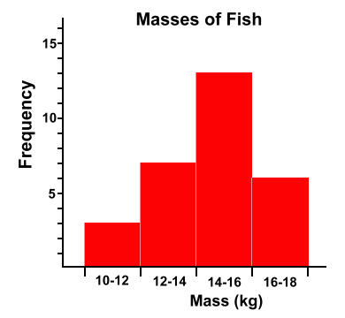
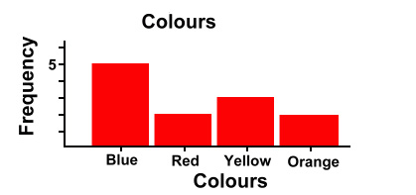
2a. Bar Graphs & Histograms
Bar graphs: discrete X variable, not grouped
  Bars don’t touch b/c discrete
Histograms: continuous X variable, grouped
  Bars touch b/c continuous

Slide 5
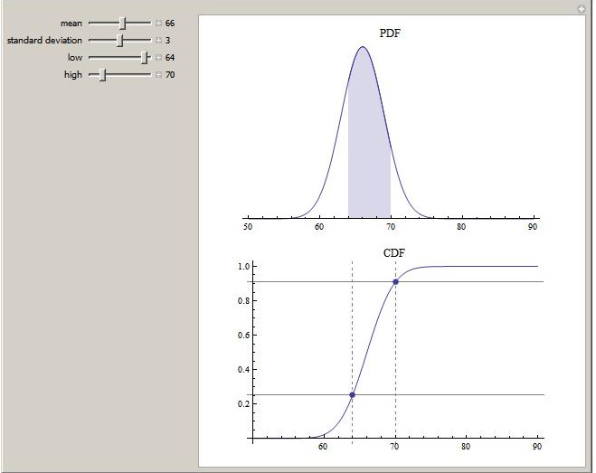
2b. Line Graphs
Regular frequency polygon = probability density function
Cumulative frequency polygon = cumulative density function

Slide 6
3. Percentiles
How an individual score compares to the scores of a specific reference group
Therefore, must pay attention to the selection of the reference group

Slide 7
3. Percentiles
Percentile: % of cases (in reference group) scoring at or below a specific score.
  Divides total cases into 100 equal parts
    eg. rank score of 90 means you were in top 10%
    eg. 90th percentile is those scoring in top 10%
Decile
  Divides total cases into 10 equal parts
Quartile
  Divides total cases into 4 equal parts

Slide 8
Computing raw score @ percentile
score = LRL + [h* (p*N-SFB)/f]
score: raw score in question
LRL: lower real limit of the interval in which the score falls (half-way between the lowest number in that interval and the highest number in the next lowest interval)
h: interval size
p: specified percentile
N: total number of cases
SFB: sum of frequencies below critical interval
f: frequency within critical interval
score at 50th percentile is called “Median”

Slide 9
4. Central Tendency quick unitary description of data
Mean
Median
Mode

Slide 10
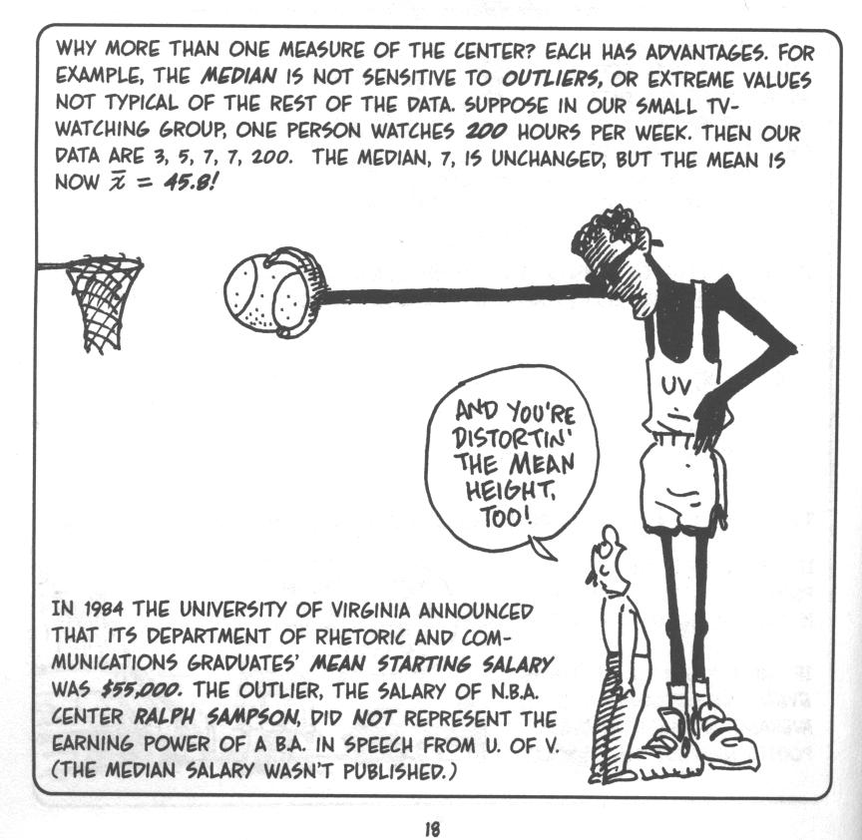

Slide 11
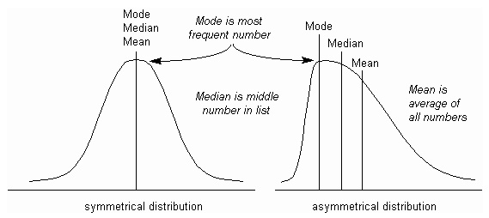
Mean, Median, & Mode
Mean: Average
Median: Middle
score at 50th percentile
Mode: Most
best used with qualitative variables

Slide 12
5. Variability measuring the spread/dispersion of data
Median: Semi-Interquartile Range
Mean: Standard Deviation & Variance

Slide 13
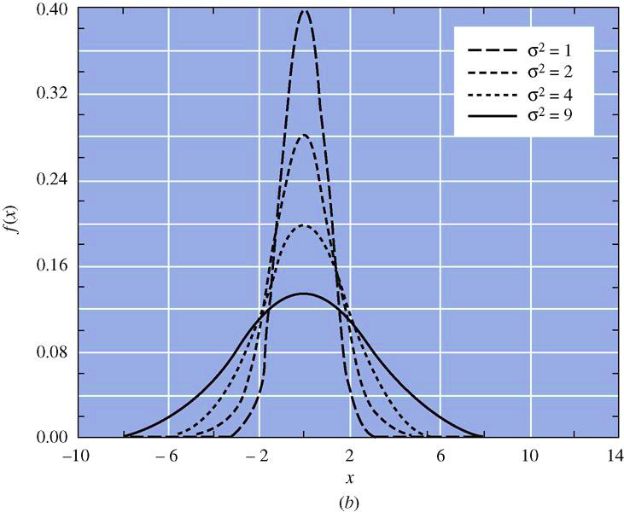

Slide 14
5a. Semi-Interquartile Range
Range
largest score – smallest score
Affected by extreme values
Interquartile (ie. inner two quartiles) range
score @ 75th percentile – score @ 25th percentile
Spread for middle 50%, not affected by extreme values
Semi-interquartile range
Merely divide the previous value by 2
Gives idea of distance of typical score from median

Slide 15
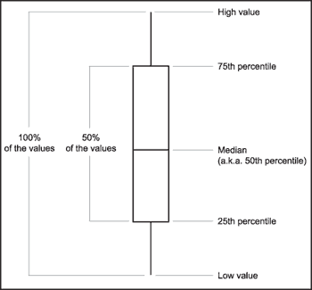
5a. Box & Whiskers Plot

Slide 16

5b. Standard Deviation & Variance
“deviation” of a score measures its distance from the center of the distribution (mean)
scores higher from the mean will have higher deviation scores, while those closer to the mean will have smaller deviation scores

Slide 17

5b. Standard Deviation & Variance
What we want is an average measure of the spread of all the scores.
However, if we simply add up all the individual deviations and divide by N, we get 0.
We can easily solve this problem by taking the absolute value of each deviation.
However, using absolute values is tricky for advanced statistics.

Slide 18
5b. Variance
Therefore, the solution is to square each of the deviations, and then take the average of this “sum of squares”. This corrects for negative numbers, and also lends itself to advance statistics.
But, there are two drawbacks:
  It alters the data by giving extra weight to data farther from the mean.
  It doesn’t yield a very interpretable number.

Slide 19

5b. Standard Deviation
In order to make the statistic more interpretable, we correct for the earlier squaring by taking the square root of the variance. This gives us the standard deviation
Low SD means the data is close to mean, and high means it is farther away from mean.

Slide 20
5b. Biased v. Unbiased Estimates
The only challenge with the previous estimates is that they are biased when you are only dealing with a sample.
To create an unbiased estimate of the population based upon your sample, you need to adjust for one less than your sample size.
This is called degrees of freedom and we will talk about it more in Chapter 10.

Slide 21
5b. Biased v. Unbiased Estimates

